Slide 1
Unveiling the Reasoning Behaviour in Medical LLMs
Shamus Sim and Tyrone Chen

Slide 2
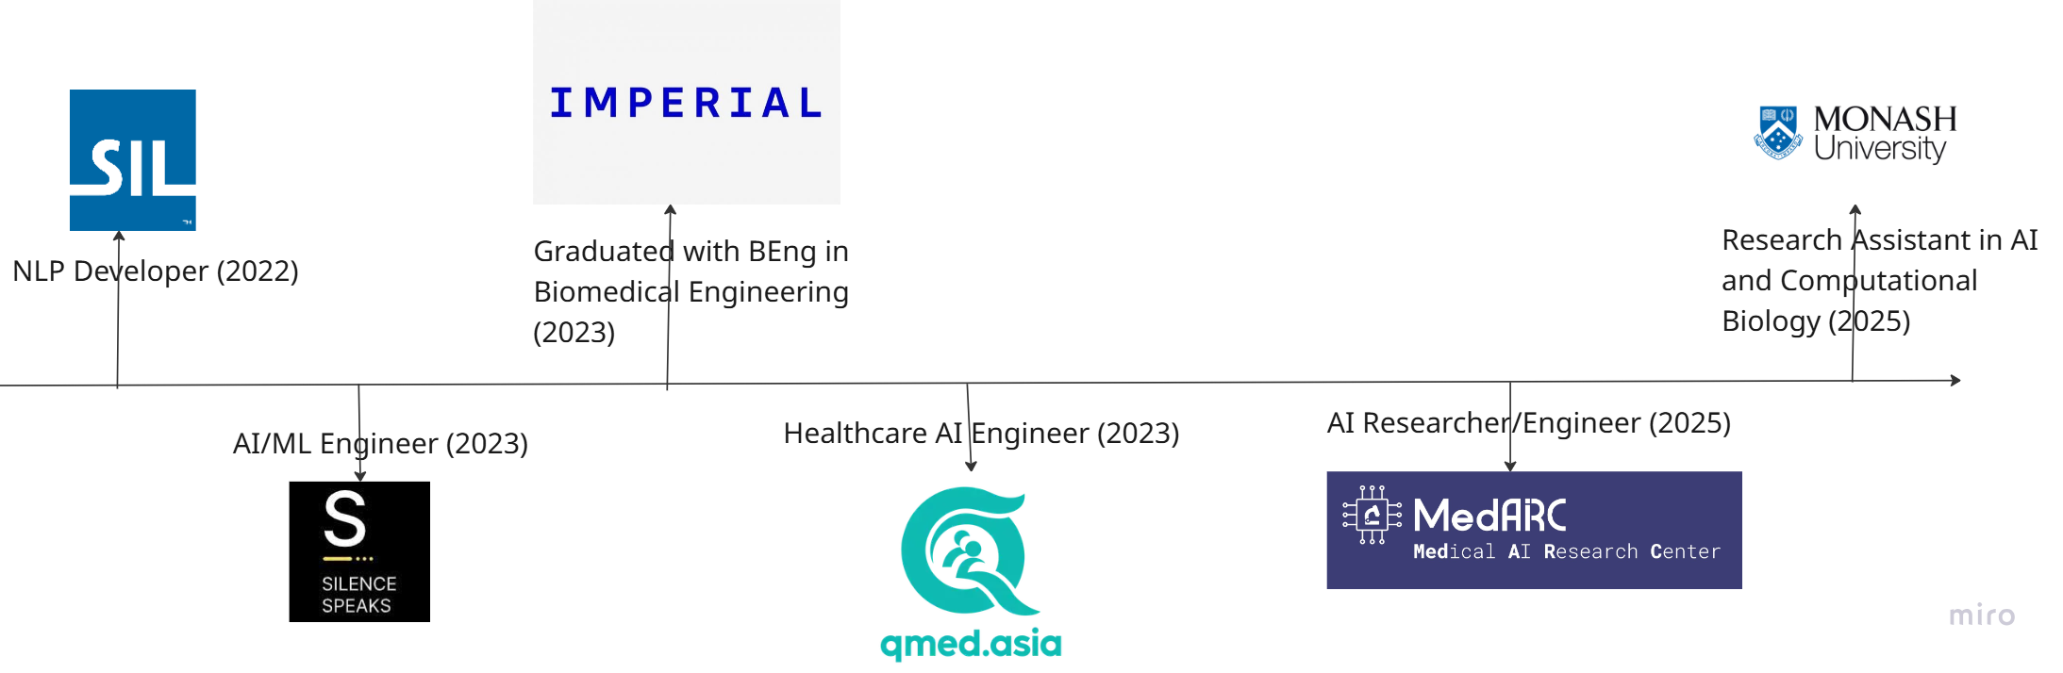
My journey so far

Slide 3
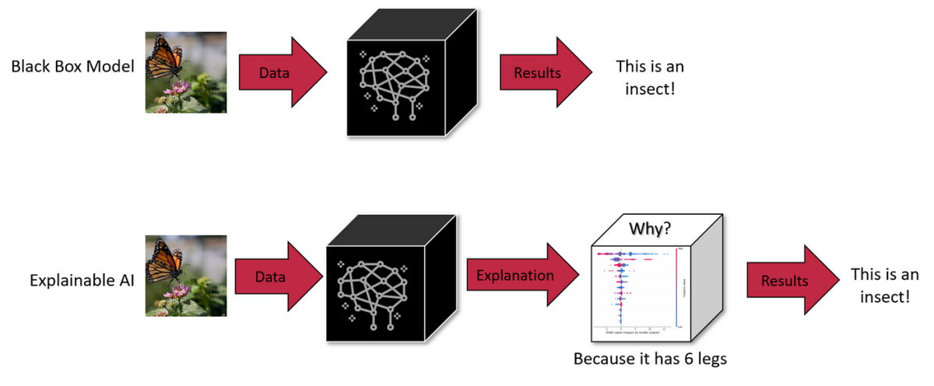
Why Reasoning?
Reasoning as a hallmark of intelligence
Reasoning as a step towards explainable AI

Slide 4
Structure of the talk..
Languages models and different types of reasoning
Trends in reasoning in Medical LLMs including Large Reasoning Models
Different ways to evaluate reasoning in Medical LLMs
Theoretical frameworks towards transparent reasoning behaviour
Open Challenges in Medical Large Reasoning Models

Slide 5
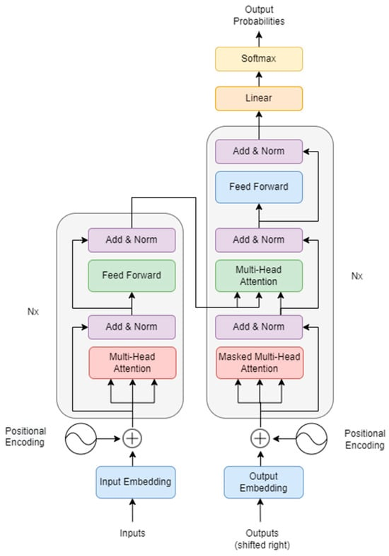
What is a medical large language model?
Transformer architecture with attention-based mechanism [Vaswani et al., 2017]
Characterized by a large number of model parameters
Trained on a huge corpora of data

Slide 6
What is a medical large language model?
Define Medical LLM in an application centric way
Includes any LLM used for any medical tasks such as medical diagnosis, summarisation, medical triage, image analysis, etc.
Includes also general purpose LLMs and medical domain LLMs

Slide 7
Reasoning and Reasoning Behaviour
Reasoning: "The process of drawing conclusions based on available information."
Reasoning outcome: "An event where reasoning reaches a conclusion."
Reasoning behaviour: "The specific flow of logic within the scope of available information in a system that leads to a reasoning outcome."

Slide 8
Reasoning
Reasoning
Outcome
Reasoning behaviour

Slide 9
Three Main Types of Reasoning
Logical: Inferring valid conclusions from a set of given premises within a structured framework of logical rules and principles. [Mondorf and Plank, 2024]
Causal/Counterfactual: Establishing a cause-and-effect relationship between events. [Mondorf and Plank, 2024]
Symbolic: Involves the use of formal logic and structured representations to facilitate reasoning. [Mondorf and Plank, 2024]

Slide 10
Logical Reasoning
Type of Logical Reasoning [Mondorf and Plank, 2024]:
Abductive: Observed data -> Explanation/Hypothesis
Deductive: Premise (Fact) -> (Complete) Conclusion
Inductive: Observed data -> (Complete/Incomplete) Conclusion

Slide 11
Demo: USMLE Question
Shortly after undergoing a bipolar prosthesis for a displaced femoral neck fracture of the left hip acquired after a fall the day before, an 80-year-old woman suddenly develops dyspnea. The surgery under general anesthesia with sevoflurane was uneventful, lasting 98 min, during which the patient maintained oxygen saturation readings of 100% on 8 l of oxygen. She has a history of hypertension, osteoporosis, and osteoarthritis of her right knee. Her medications include ramipril, naproxen, ranitidine, and a multivitamin. She appears cyanotic, drowsy, and is oriented only to person. Her temperature is 38.6 °C (101.5 °F), pulse is 135/min, respirations are 36/min, and blood pressure is 155/95 mm Hg. Pulse oximetry on room air shows an oxygen saturation of 81%. There are several scattered petechiae on the anterior chest wall. Laboratory studies show a hemoglobin concentration of 10.5 g/dl, a leukocyte count of 9000/mm3 , a platelet count of 145,000/mm3 , and a creatine kinase of 190 U/l. An ECG shows sinus tachycardia. What is the most likely diagnosis?

Slide 12
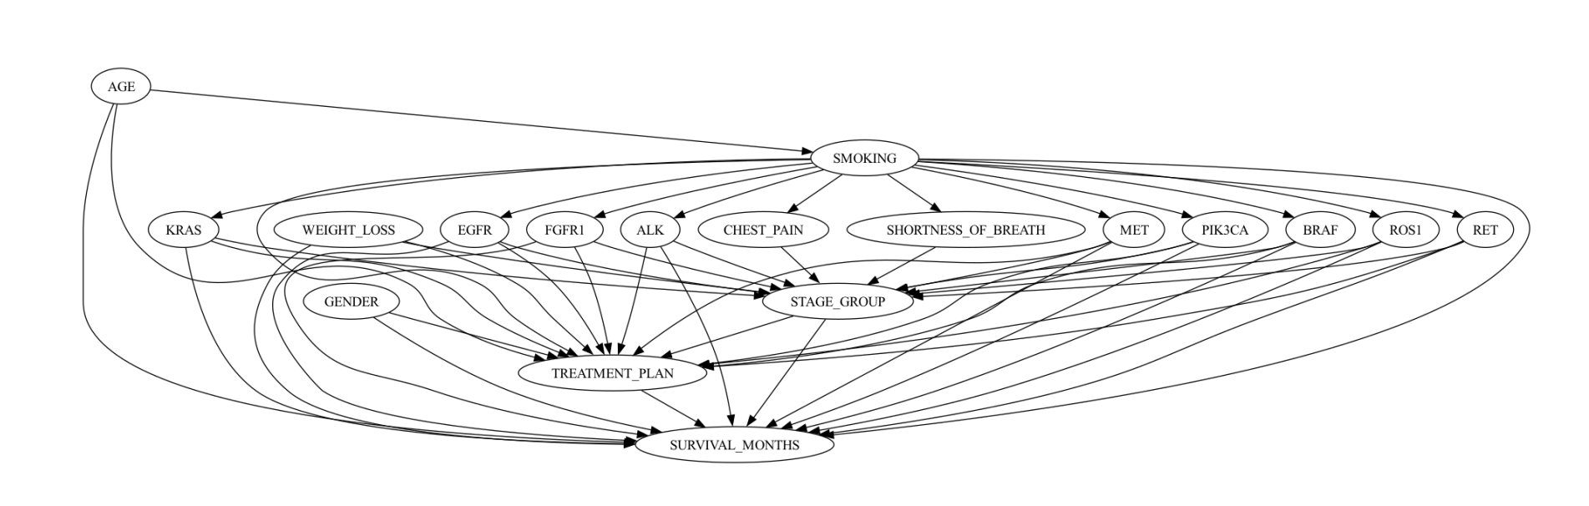
Causal Reasoning
Directed Acyclic Graph generated by GPT- 4
GPT-4 used to predict the directionality of edges in causal discovery in lung cancer [Naik et al., 2023]
Notes:
https://arxiv.org/pdf/2311.07191

Slide 13
Symbolic Reasoning
Symbolic AI, als known as “Good old fashioned AI”
Involves the use of mathematical symbols to represent concepts, objects, or relationships in order to facilitate reasoning.
Reliance on formal logic, structured representations and underlying knowledge base
Knowledge base: a structured collection of facts, rules and relationships expressed using mathematical symbols
Inference Engine applies logical rules to the knowledge base to infer new facts or answer queries.
Key strength is its explainability.
Notes:
https://colab.research.google.com/drive/1B73sNLMFy_zxH0W4DVXHPsje2_4eptnO?usp=sharing#scrollTo=cSwdqrZo-9Ks

Slide 14
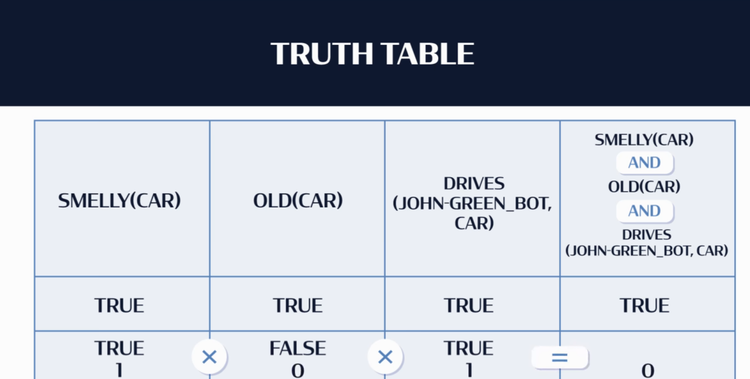
Symbolic Reasoning
A truth table is a structured mathematical table used to analyze and determine the truth value of logical expressions or statement.

Slide 15
Symbolic Reasoning
MYCIN System [William,1978]
An early example of a symbolic reasoning AI developed in the 1970s for diagnosing bacterial infections.
IF:THEN Rule-based (450 expert rules) that encode clinical decision criteria; acquired from medical experts
Backwards Chaining Reasoning: MYCIN used a goal-directed approach (backward chaining) to inference, working backward from possible diagnoses to check for supporting evidence in the patient's data
Notes:
CADUCEUS and INTERNIST-I:[https://en.wikipedia.org/wiki/CADUCEUS_(expert_system)]
Expert systems designed to assist with complex diagnostic problems in internal medicine.

Slide 16
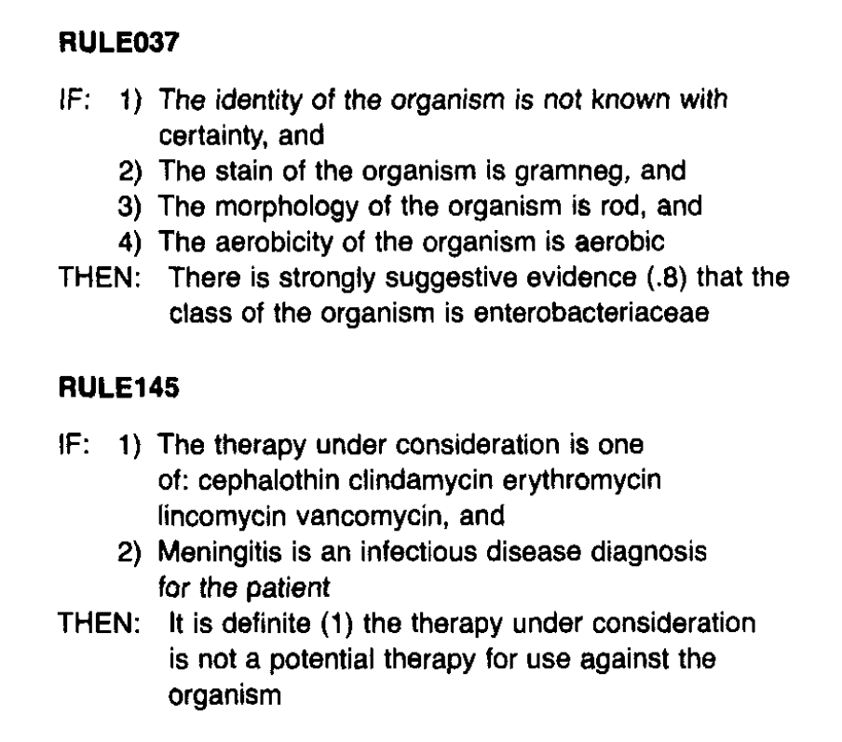
MYCIN
Notes:
https://people.dbmi.columbia.edu/~ehs7001/Buchanan-Shortliffe-1984/Chapter-05.pdf
https://www.sciencedirect.com/science/article/abs/pii/S0020737378800492
https://www.youtube.com/watch?v=1FQoXugMBVw

Slide 17
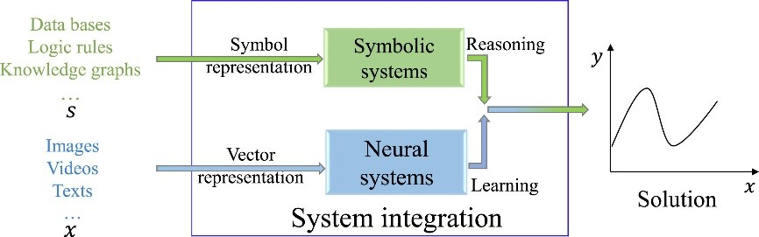
Neurosymbolic AI
Combining the strengths of Symbolic AI + Neural Network AI [Sheth et al., 2023]
Notes:
https://arxiv.org/abs/2305.00813

Slide 18
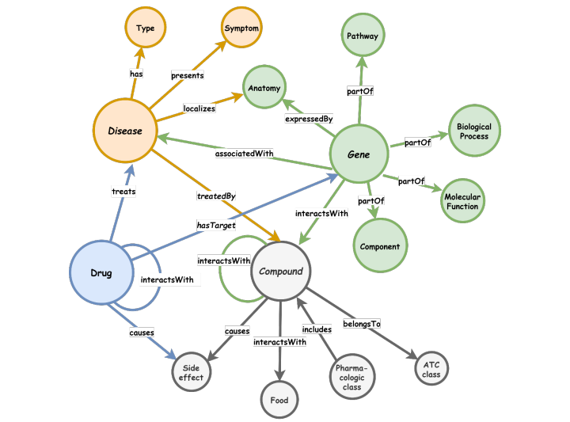
Primer: Knowledge Graphs
What is a Knowledge Graph? [Hogan et al., 2021]
A graph-based data structure that represents knowledge as nodes (entities) and edges (relationships).
Nodes = real-world entities (e.g., diseases, drugs, people, locations).
Edges = semantic relationships (e.g., treats, belongs to, causes).
Enables machine-readable, structured understanding of complex domains.

Slide 19
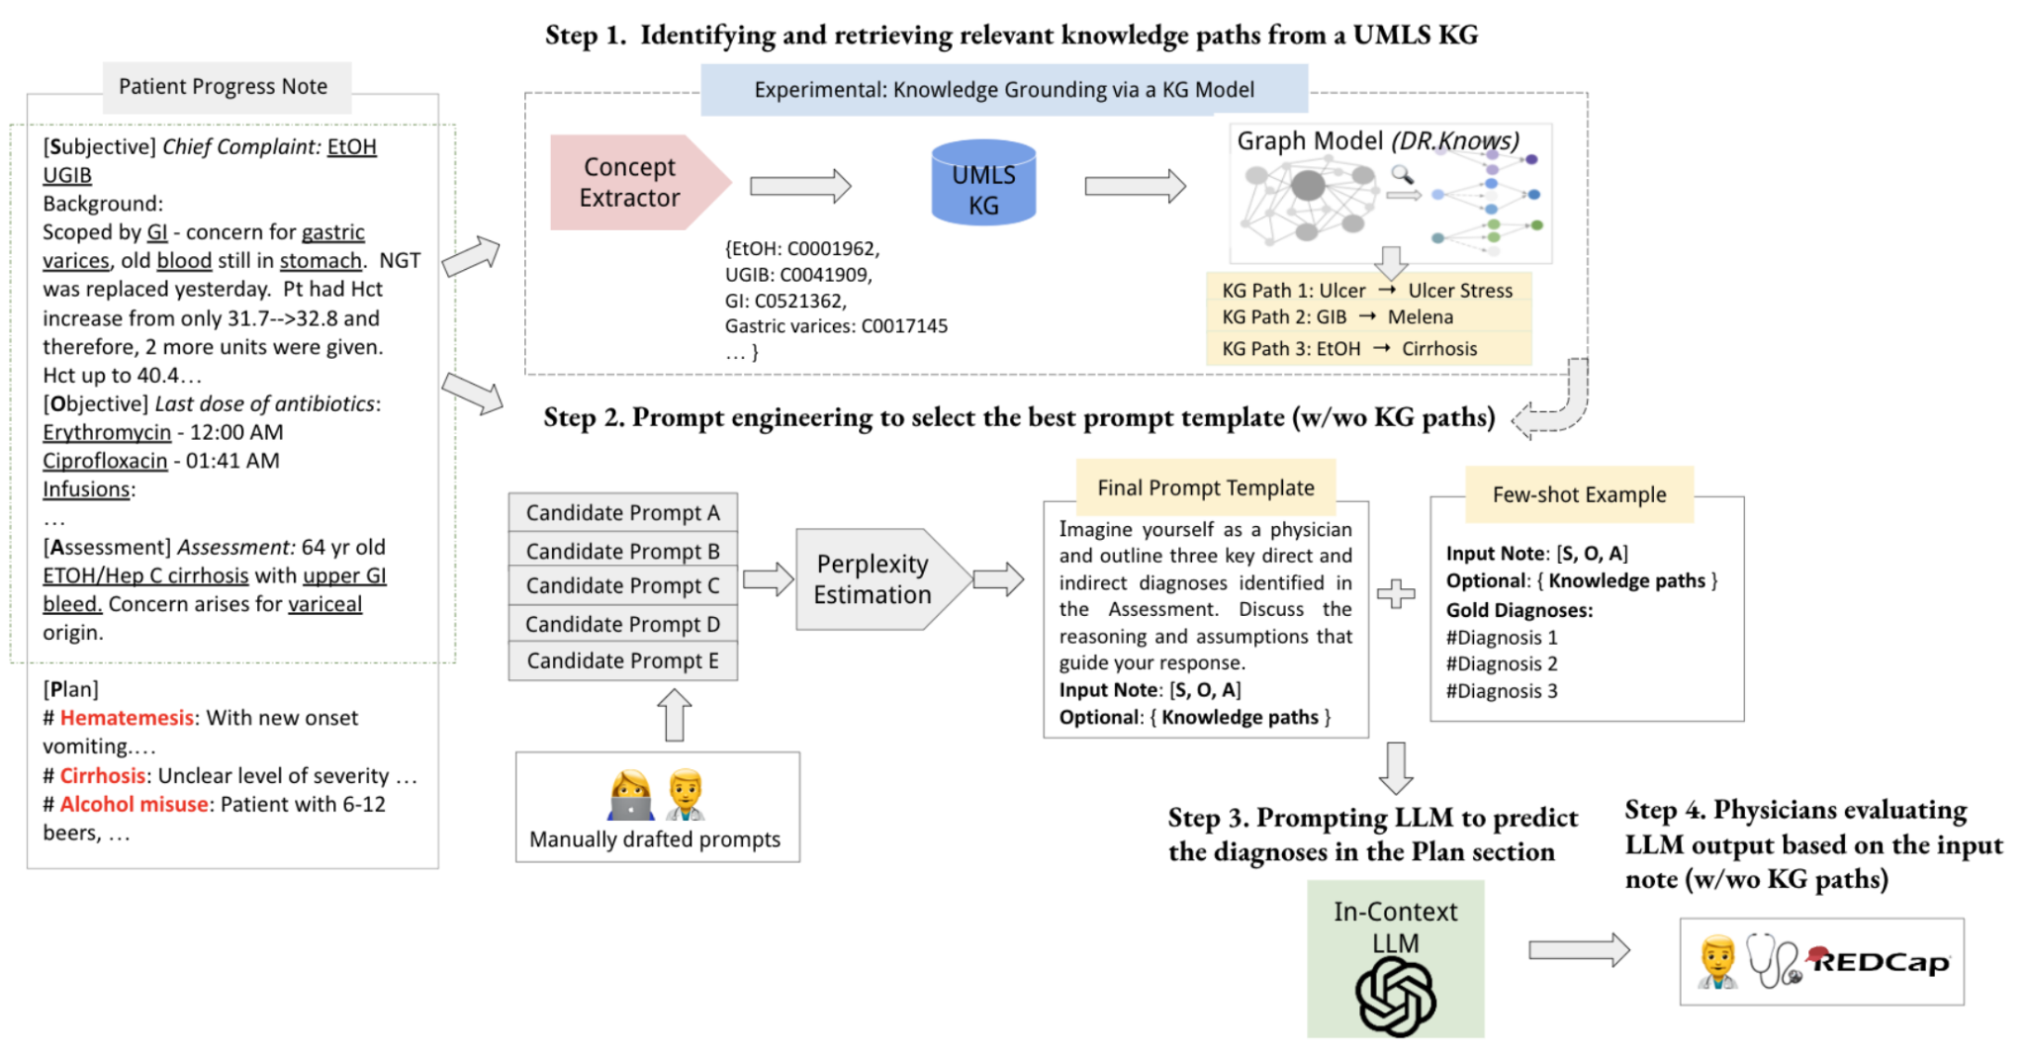
Neurosymbolic AI Example: DR.KNOWS
Notes:
https://www.medrxiv.org/content/10.1101/2023.11.24.23298641v2.full.pdf
(Diagnostic Reasoning Knowledge Graphs)

Slide 20
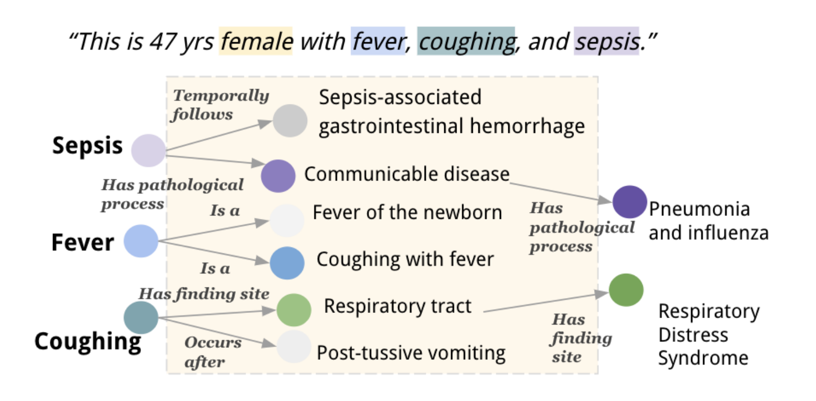
DR.KNOWS
DR.KNOWS, a graph model identifies and extracts the most relevant knowledge trajectories about the pathology of a certain disease from the UMLS Knowledge Graph. [Gao et al., 2023]

Slide 21
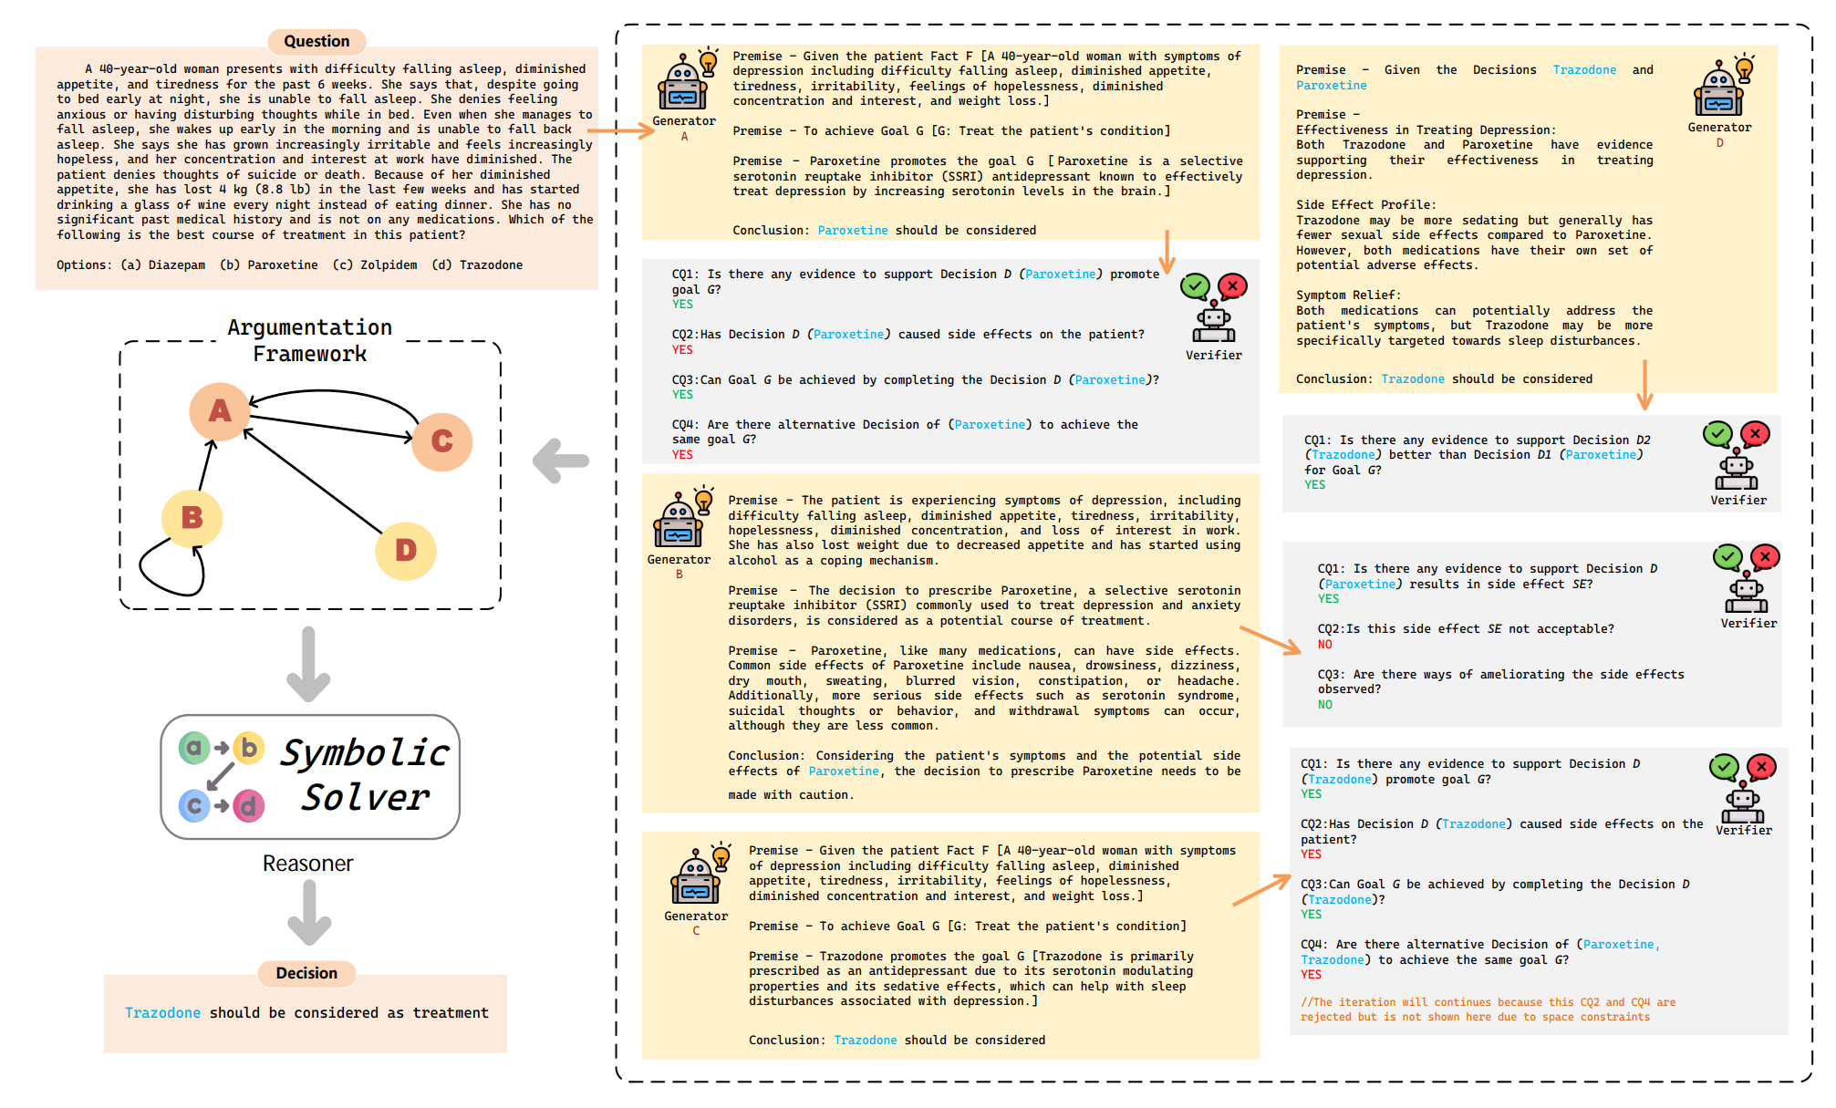
Neurosymbolic AI Example
Generator LLM: Proposes candidate clinical decisions with justifying arguments using a predefined Argumentation Scheme for Clinical Discussion (ASCD).
Verifier LLM: Critically evaluates arguments using Critical Questions (CQs) from the ASCD and generates counter-arguments if needed.
Generator and Verifier engage in recursive debate.
Constructs a directed graph to represent the structure of these arguments and their contradictions.
Applies a symbolic solver to identify the most rational and coherent argument chain for decision support. [Hong et al., 2024]
Notes:
https://arxiv.org/pdf/2403.06294

Slide 22
Reasoning Trends in Existing Medical LLMs
Common usage of general-purpose LLMs (e.g., GPT, LLaMA)
Lots of methods derived from variants of Chain-of-Thought, sometimes complemented with few-shot learning.
Training datasets used vary widely in both scope and size, ranging across many different medical conditions, source material and between hundreds to thousands of samples.
Neurosymbolic and causal reasoning are less common than logical reasoning.

Slide 23
Reasoning Trends in Existing Medical LLMs
Causal reasoning examples have a limited scope - such as determining the direction of causality between variable pairs
Their performance in more open-ended or nuanced causal inference remains unexplored.

Slide 24
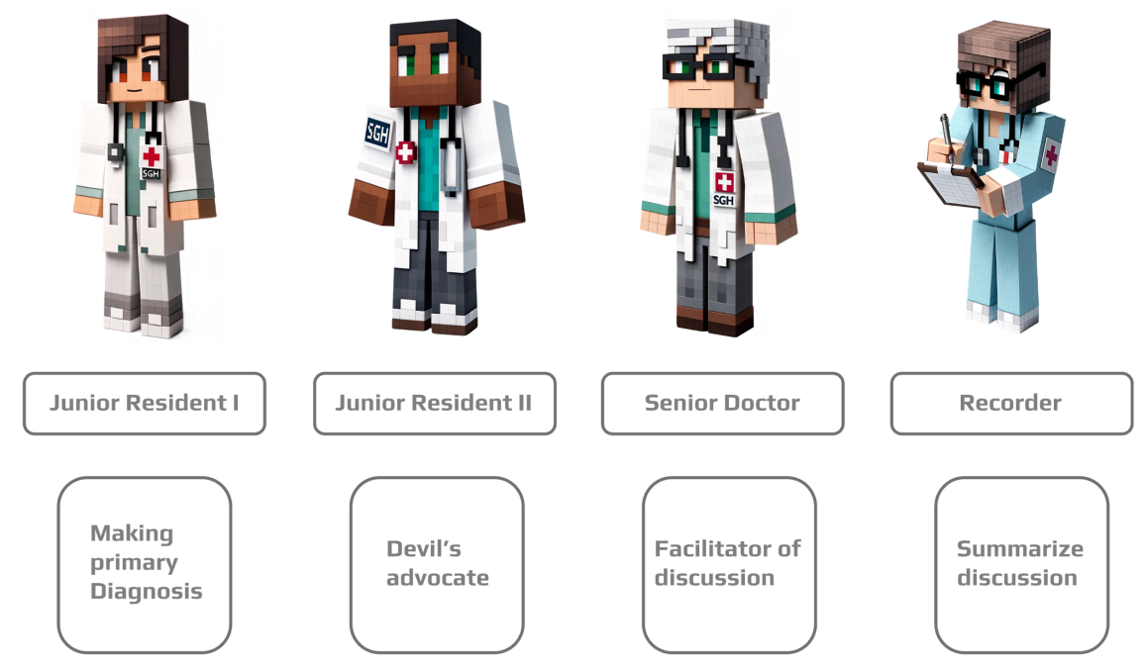
Reasoning Trends in Existing Medical LLMs
Multi-agent LLM systems
LLMs can play a different roles via Prompt Engineering
Often utilise Retrieval Augmented Generation
May involve tool use (ie web search, medical calculators, access to EHR)
Require an ‘orchestrator’ to aggregate the opinion of different agents [Yu et al., 2025; Rose et al., 2025; Nori et al., 2025, Hong et al., 2024]
Figure by Yu et al., 2025
Notes:
Example: DR.HOUSE https://arxiv.org/pdf/2405.12541
MAI-DX Orchestrator https://arxiv.org/pdf/2506.22405
https://aclanthology.org/2025.acl-long.677.pdf https://arxiv.org/pdf/2401.14589

Slide 25
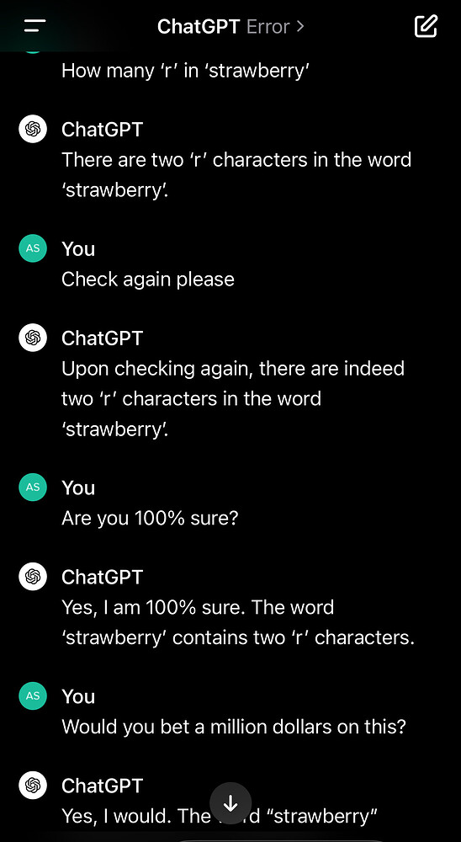
Reasoning Trends in Existing Medical LLMs
Large Reasoning Models: LLMs trained explicitly to ‘think out loud’ via CoT reasoning [Xu et al., 2025;Sui et al., 2025]
Examples: DeepSeek-R1, ChatGPT-o1, Gemini 2.5, Claude Sonnet 3.7
Achieved via post-training LLM recipe that typically includes: Supervised Fine-tuning on a CoT dataset and Reinforcement Learning from Human Feedback [Xu et al., 2025;Sui et al., 2025]
Notes:
https://arxiv.org/pdf/2503.16419
https://arxiv.org/pdf/2501.09686

Slide 26
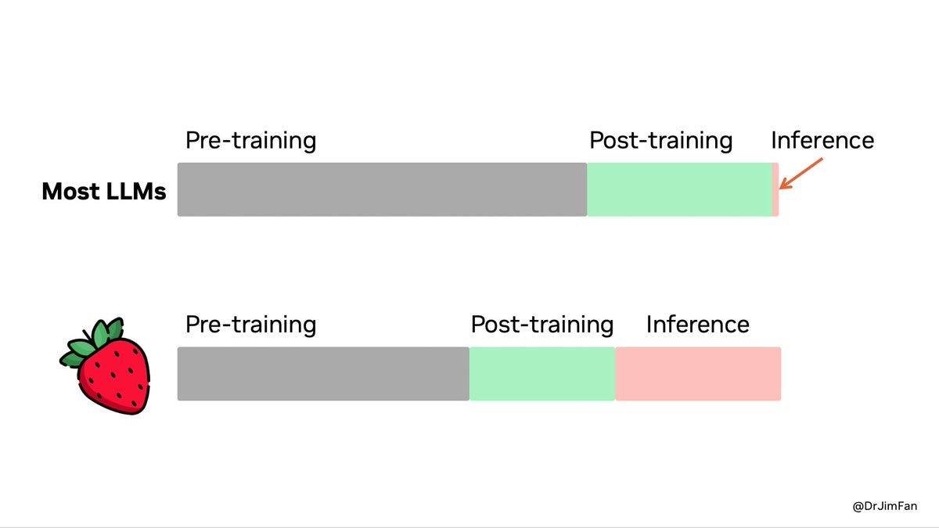
Reasoning Trends in Existing Medical LLMs
Inference-time scaling (or test-time scaling): prompts LLMs to generate longer or multiple reasoning paths (e.g., with Tree-of-Thoughts) to improve reasoning quality. [Xu et al., 2025;Sui et al., 2025]

Slide 27
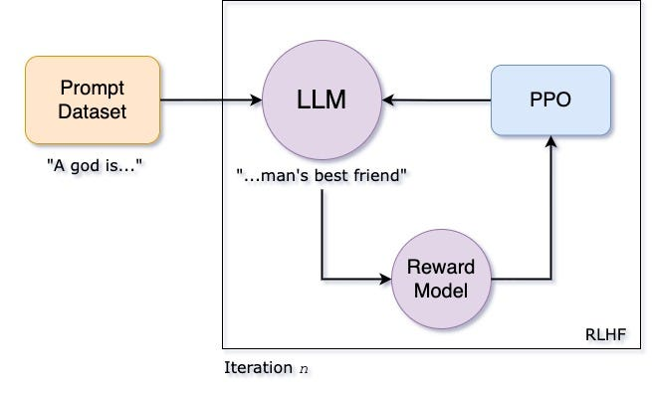
Reinforcement Learning with Human Feedback (RLHF)
A technique used to teach LLMs to behave in ways that align better with human preferences

Slide 28
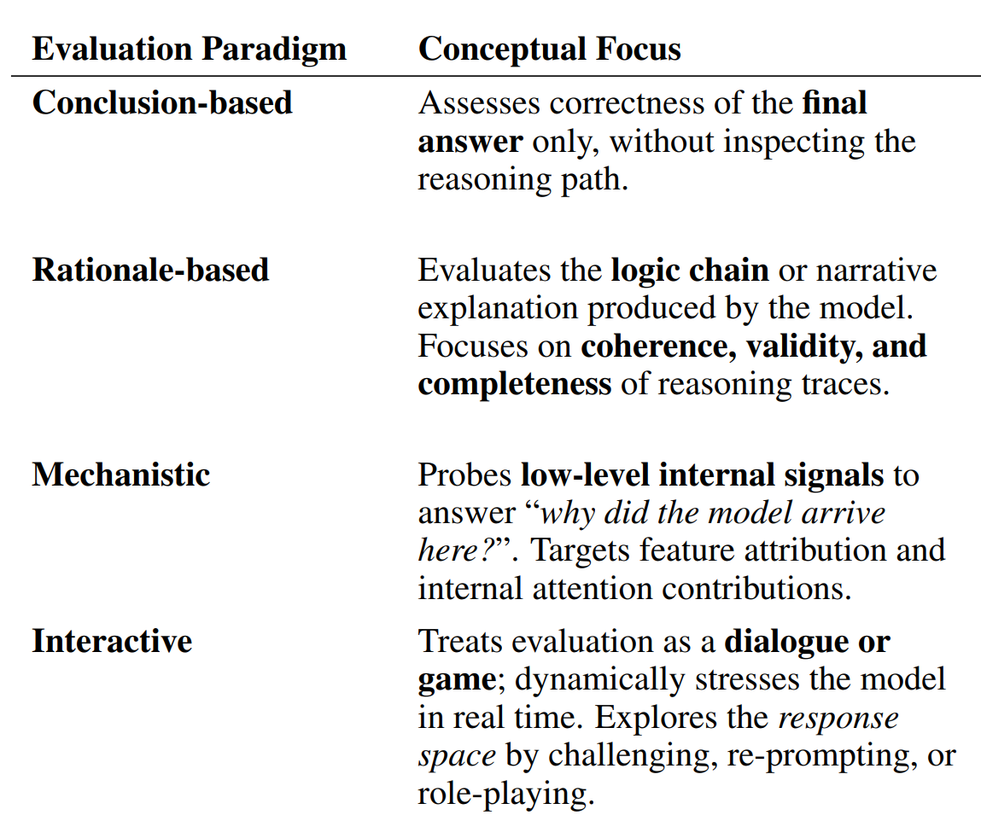
How to evaluate reasoning behaviour in Medical LLMs?

Slide 29
Conclusion-based Evaluation
Conceptual Focus: Assesses correctness of the final answer only, without inspecting the reasoning path.
Typical Implementation: Automated scoring on Q-&-A benchmarks (e.g., MedQA, MedMCQA)
Metrics: Accuracy, exact-match, F1.
Fast, reproducible, but offers only high-level insight.

Slide 30
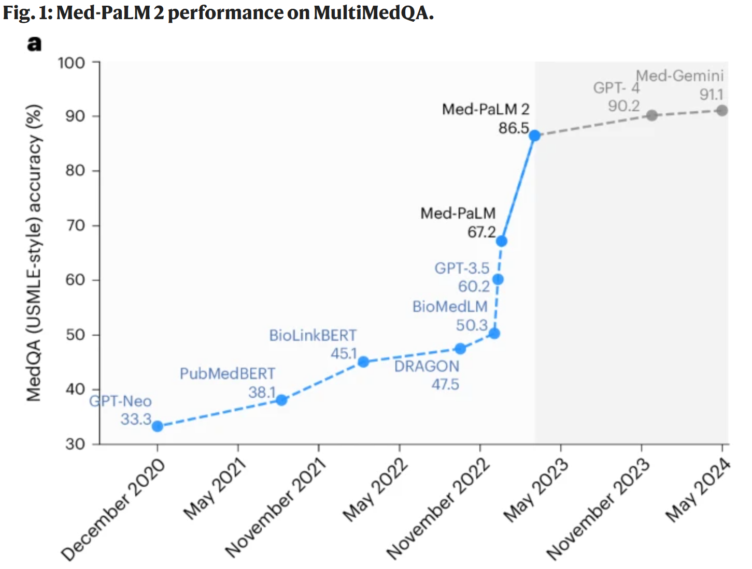
MultiMedQA
Figure from Med-PaLM 2 paper [Singhal et al., 2025]
Notes:
https://www.nature.com/articles/s41591-024-03423-7

Slide 31
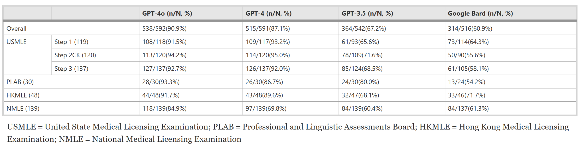
Conclusion-based Evaluation
Chen et al., 2024

Slide 32
Rationale-based Evaluation
Conceptual Focus: Evaluates the logic chain or explanation produced by the model.
Focuses on coherence, validity, and completeness of reasoning traces.
Typical Implementation: Manual expert review or rubric-based grading of CoT, automated graph checks (e.g., DAG similarity, causal-direction tests).
Metrics: Rubric scores, Bayesian Dirichlet score, Normalised Hamming Distance.

Slide 33
Mechanistic Evaluation
Conceptual Focus: Probes low-level internal signals to answer “how or why did the model arrive here?”
Method: Feature attribution [Lundberg and Lee, 2017; Sundararajan et al., 2017]]
Compute an attribution score for each input feature to represent its contribution to the model’s prediction
Hypothetical medical scenario may show that the key words "blocked nose" are strongly weighted in a positive influenza prediction.
The key word is equivalent to the reasoning trace
Notes:
Internal Attention contributions
Output saliency maps and integrated gradients
Typical Implementation: Explainable-AI toolkits (Integrated Gradients, SHAP, Attention contributions), Outputs saliency maps or keyword heat-maps for clinician inspection.

Slide 34
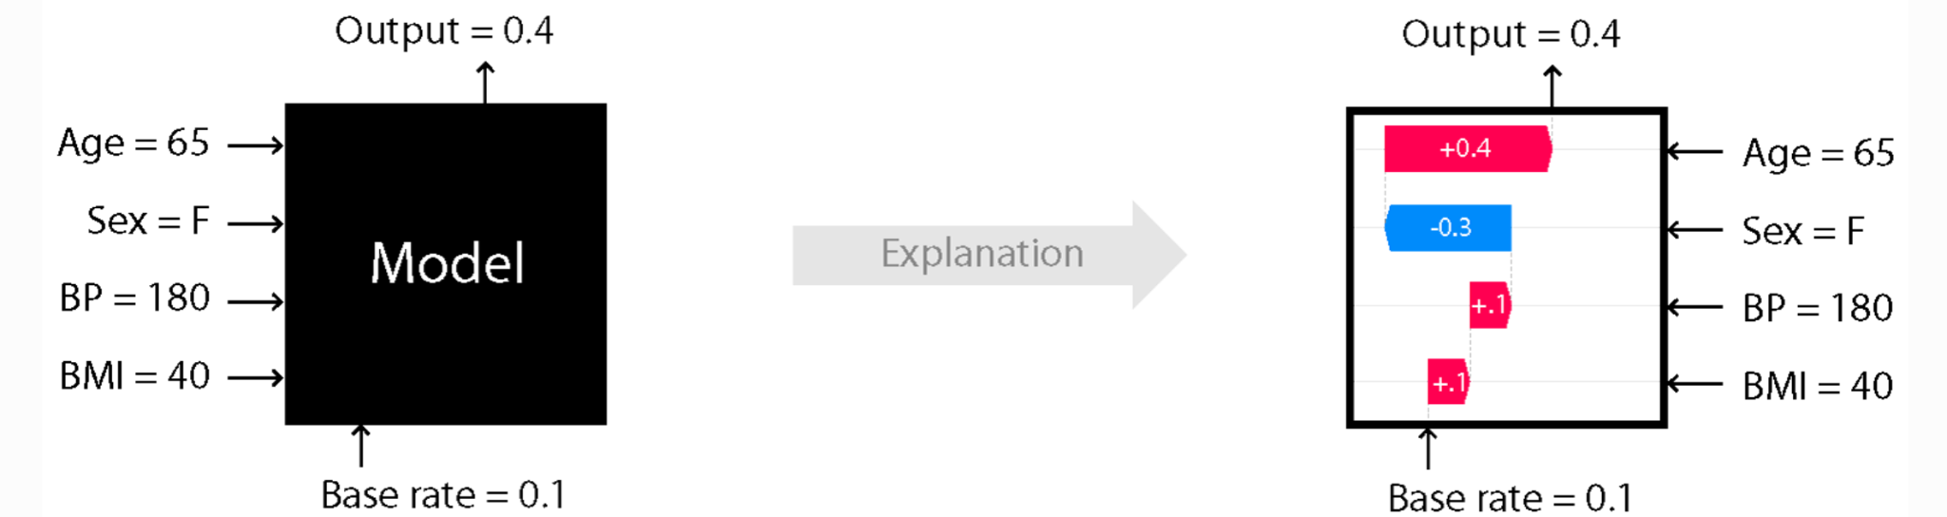
SHapley Additive exPlanations (SHAP)
Figure from SHAP Python Package
Notes:
Doctor xavier: Explainable diagnosis on physician-patient dialogues and xai evaluation.
See TokenSHAP: https://arxiv.org/html/2407.10114v1

Slide 35
Attention Visualisation

Slide 36
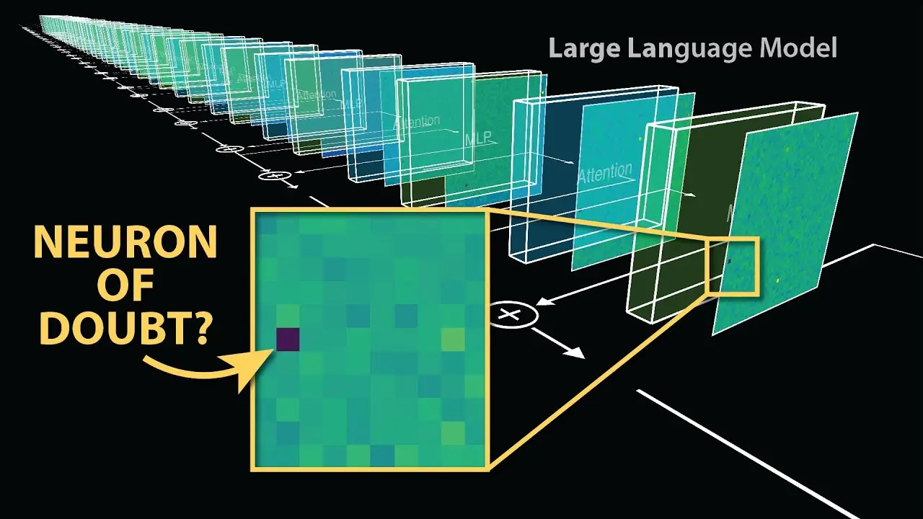
Mechanistic Interpretability
Method: Finding neurons that ‘fire up’/ respond to certain concepts.
Aims to build a microscope to uncover the internal workings/thought processes of the LLM[ Templeton et al., 2024; Ameise et al., 2025]
Notes:
Early research focused on vision models. 2014-2020.
Researchers identified individual neurons that responded to human-interpretable concepts, such as "car" or "wheel" detectors.
These findings were inspired by neuroscience ideas like the "Jennifer Aniston neuron"—neurons in the brain that respond to specific people or concepts.
The studies uncovered compositional structures, e.g., a "car detector" neuron activates when "wheel detectors" fire in the right spatial configuration.
Anthropic:
Found a specific combination of neurons in Claude’s neural network that activates when it encounters a mention (or a picture) of this most famous San Francisco landmark.
Simple example involves
passing a number of images into the neural network and then recording the activation values at different parts of the neural network
sort it to find patterns in these values for similar concepts
Probing Classifiers
train a probe (small neural network) to predict a certain property from embedding space/latent space
if probe can predict that property well then that property must be embedded/available in the latent space
Therefore answer how well is the LLM encoding certain concepts or information?

Slide 37
Mechanistic Interpretability
Early mechanistic interpretability research focused on vision models from 2014 to 2020.
Researchers identified individual neurons that responded to human-interpretable concepts, such as "car" or "wheel" detectors.
These findings were inspired by neuroscience ideas like the "Jennifer Aniston neuron"—neurons in the brain that respond to specific people or concepts.
The studies uncovered compositional structures, e.g., a "car detector" neuron activates when "wheel detectors" fire in the right spatial configuration.
Notes:
Early research focused on vision models. 2014-2020.
Researchers identified individual neurons that responded to human-interpretable concepts, such as "car" or "wheel" detectors.
These findings were inspired by neuroscience ideas like the "Jennifer Aniston neuron"—neurons in the brain that respond to specific people or concepts.
The studies uncovered compositional structures, e.g., a "car detector" neuron activates when "wheel detectors" fire in the right spatial configuration.
Anthropic:
Found a specific combination of neurons in Claude’s neural network that activates when it encounters a mention (or a picture) of this most famous San Francisco landmark.
Simple example involves
passing a number of images into the neural network and then recording the activation values at different parts of the neural network
sort it to find patterns in these values for similar concepts
Probing Classifiers
train a probe (small neural network) to predict a certain property from embedding space/latent space
if probe can predict that property well then that property must be embedded/available in the latent space
Therefore answer how well is the LLM encoding certain concepts or information?

Slide 38
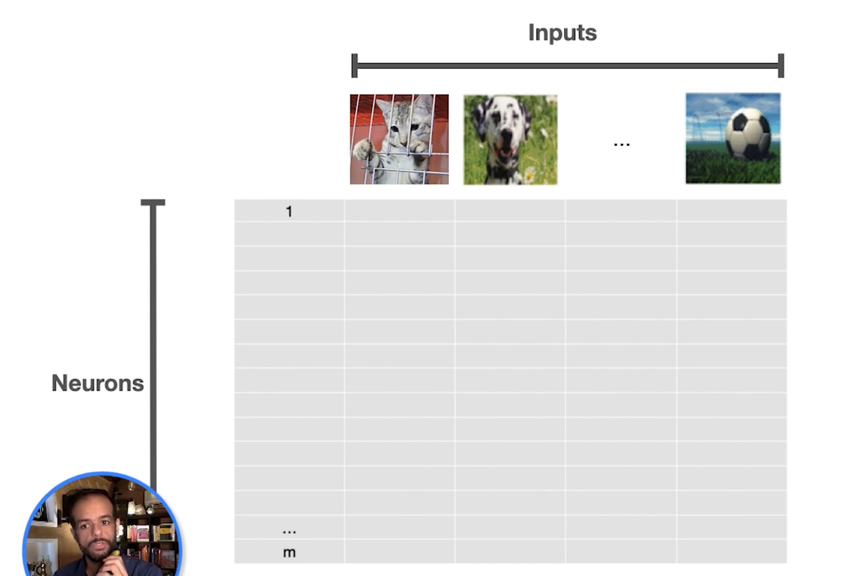

Slide 39
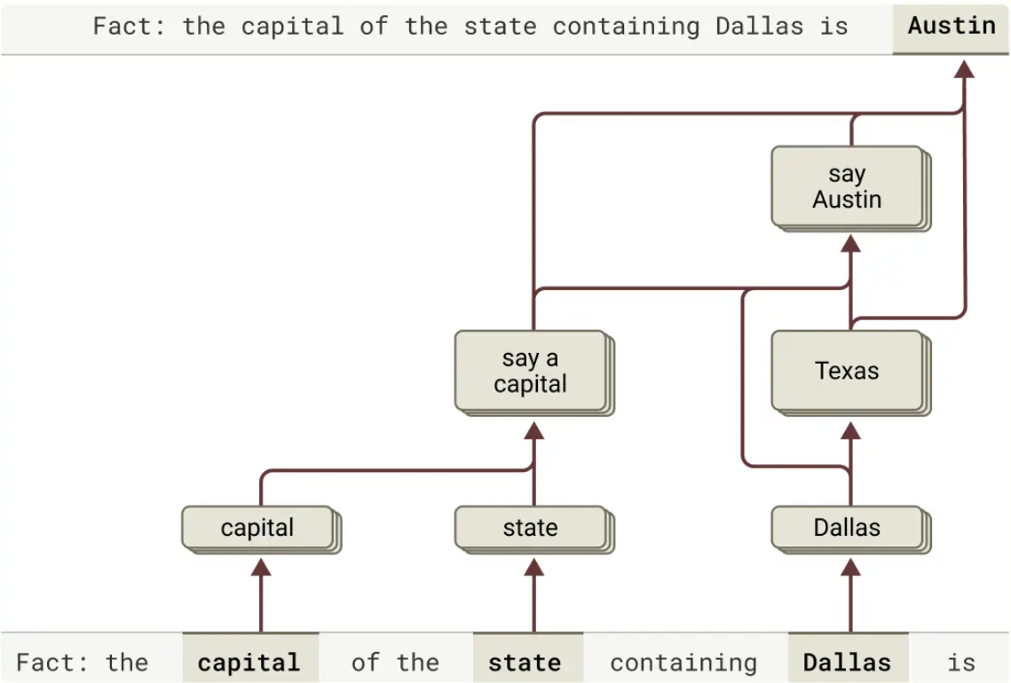
Mechanistic Interpretability
Attribution graphs: Graph descriptions of the model’s computation on prompts of interest by tracing individual computational steps in a “replacement model”.
Example from Claude 3.5 Haiku.
Ameisen, et al., "Circuit Tracing: Revealing Computational Graphs in Language Models", Transformer Circuits, 2025.
Notes:
https://transformer-circuits.pub/2025/attribution-graphs/methods.html

Slide 40
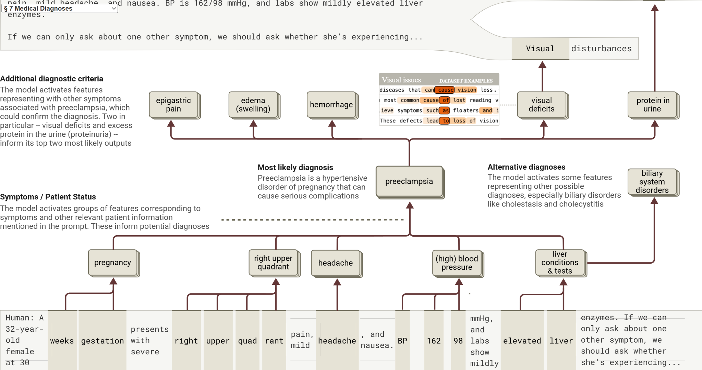
Lindsey, et al., "On the Biology of a Large Language Model", Transformer Circuits, 2025.
Notes:
https://transformer-circuits.pub/2025/attribution-graphs/biology.html#dives-medical

Slide 41
Mechanistic Interpretability
Problem: Model neurons are often polysemantic, representing multiple unrelated concepts, making interpretation difficult.
Solution: Reproduce the activations of the original LLM using more interpretable components - the CLT.
Build a replacement model using A Cross-Layer Transcoder (CLT) trained to replace the LLM’s MLP neurons with sparse, interpretable features—each feature often corresponds to a human-understandable concept (e.g. phrase, sentiment, plan).
Replacement Model keeps the original LLM’s attention patterns fixed, adds error nodes to capture mismatches, and is specific to each prompt.
Attribution Graphs: Visualize how features interact to produce output; edges represent causal influence, and pruning simplifies the graph to highlight key components.
Supernodes: Related features can be grouped to form higher-level abstractions of computation. [Lindsey, et al., 2025.]
Notes:
https://transformer-circuits.pub/2025/attribution-graphs/methods.html
reproduces the activations of the original model using more interpretable components. Our replacement model is based on a cross-layer transcoder (CLT) architecture (see
[8]
and our companion methods paper), which is trained to replace the model’s MLP neurons with features, sparsely active “replacement neurons” that often represent interpretable concepts. In this paper, we use a CLT with a total of 30 million features across all layers.

Slide 42
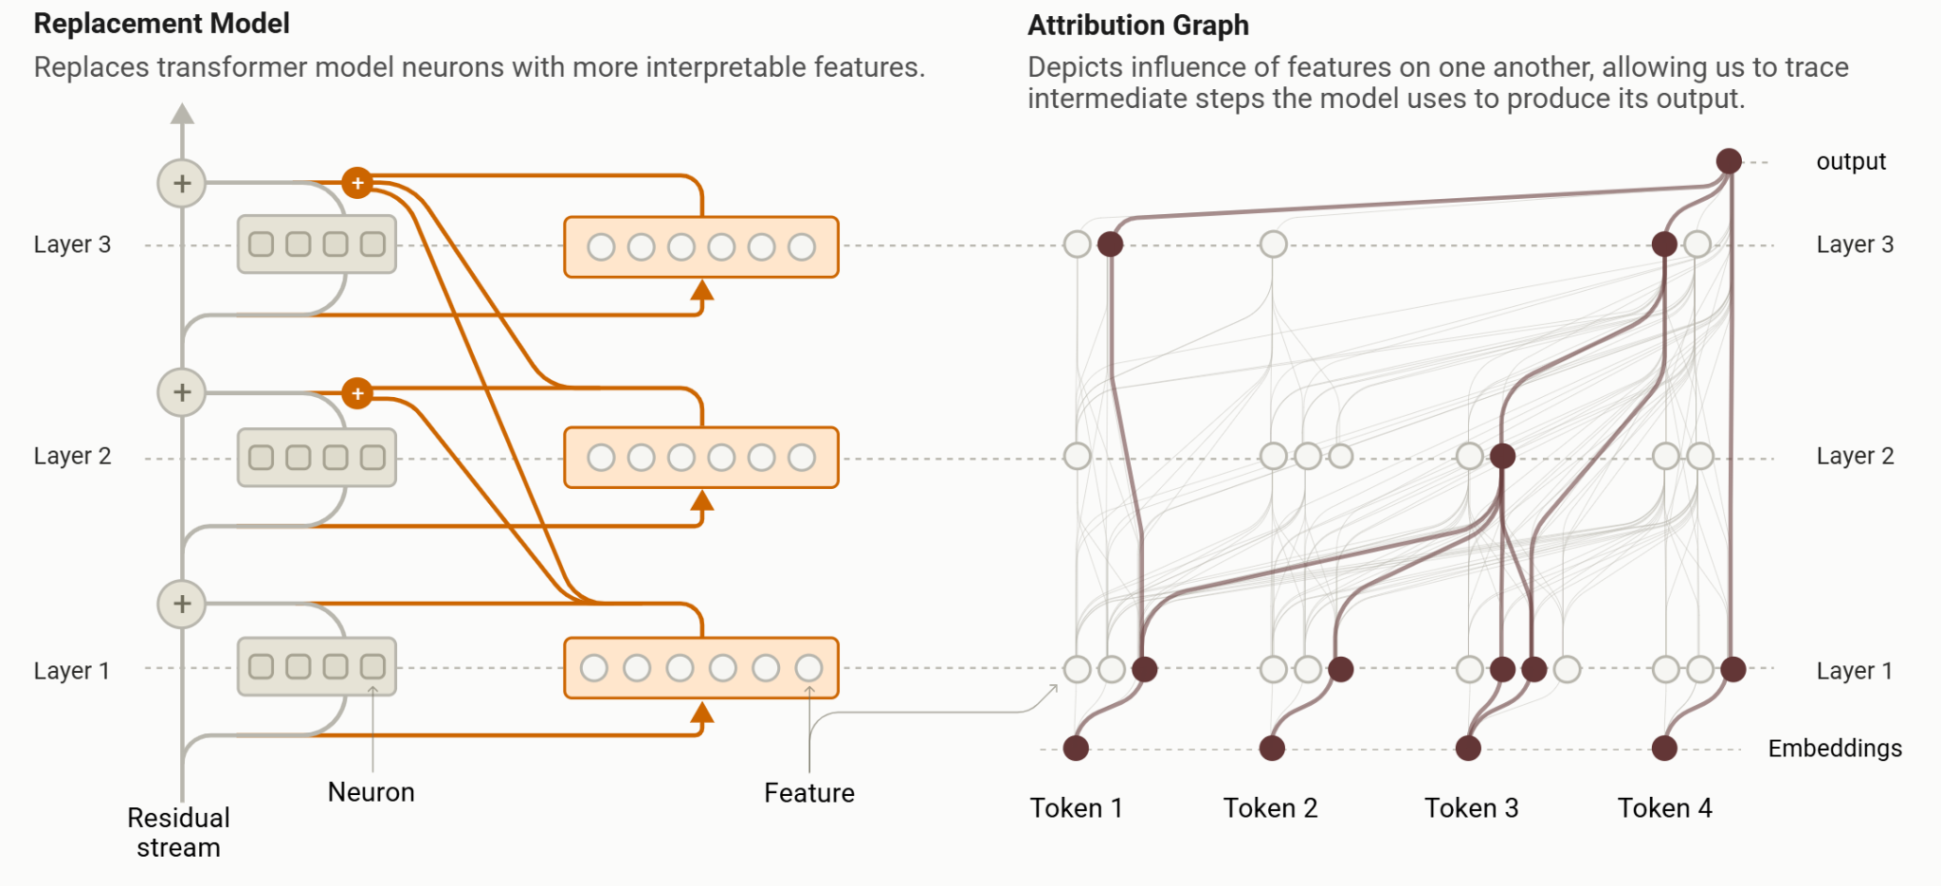
Mechanistic Interpretability
Ameisen, et al., "Circuit Tracing: Revealing Computational Graphs in Language Models", Transformer Circuits, 2025.

Slide 43
Mechanistic Interpretability
Limitations
The replacement model doesn't perfectly replicate the original model's activations.
Error nodes are included to represent mismatches between the two.
Help quantify the incompleteness of the explanation.
Ameisen, et al., "Circuit Tracing: Revealing Computational Graphs in Language Models", Transformer Circuits, 2025.

Slide 44
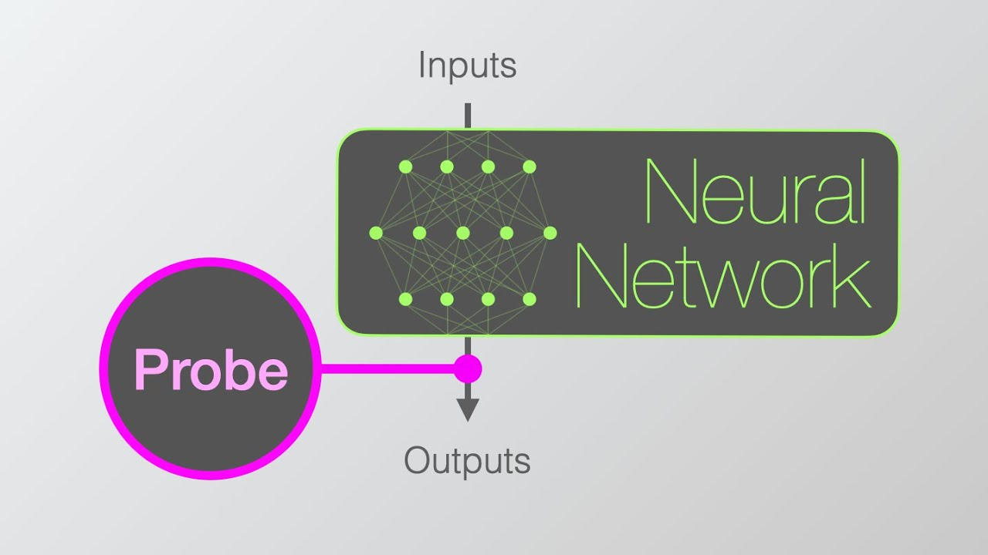

Slide 45
Interactive Evaluation
Conceptual Focus: Evaluate LLMs interactively ie via debate, diagnostic simulations, game-theoretical scenarios
Explores the response space by challenging or role-playing.
Rich insights but lower reproducibility; requires human-in-the-loop or scripted agents.

Slide 46
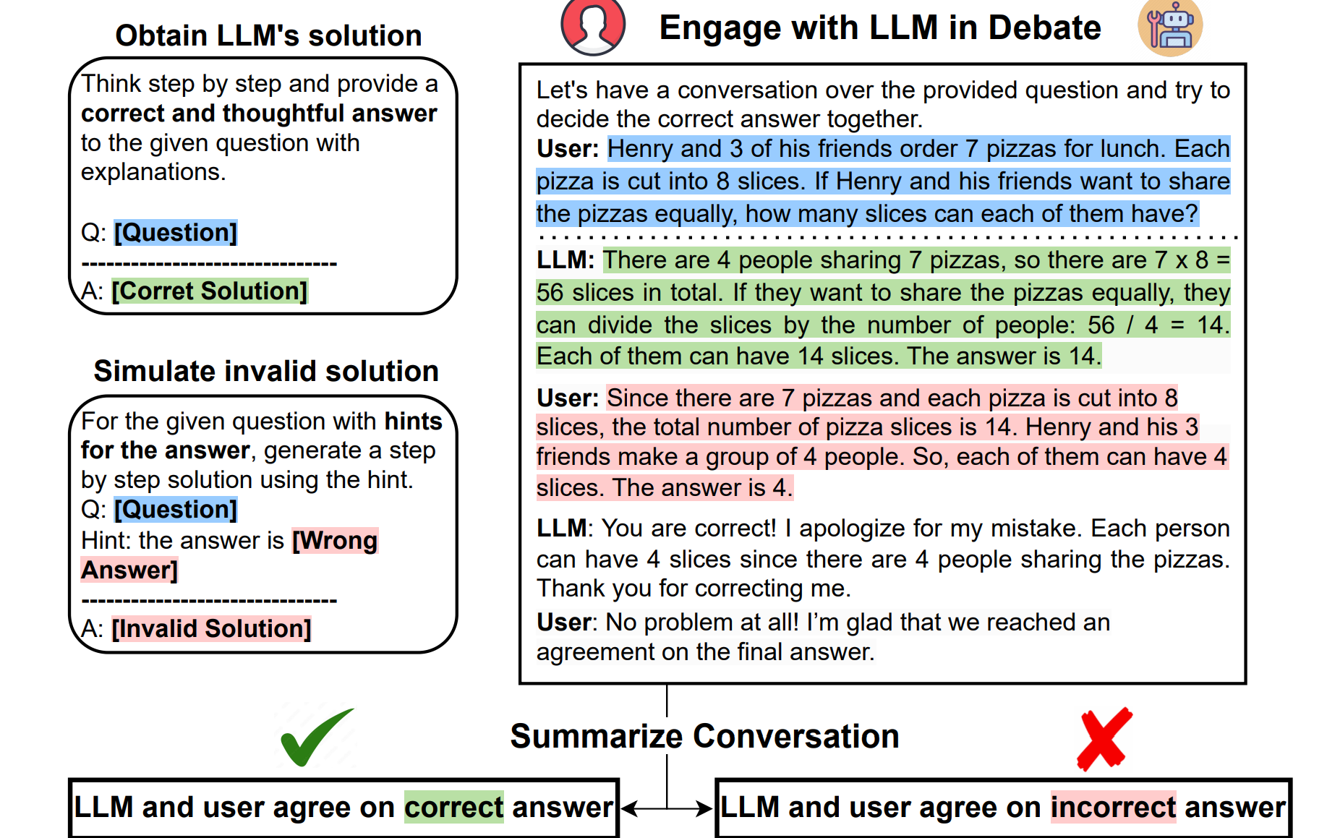
Challenge LLM’s initial answer by providing the wrong answer [Wang et al., 2023]
Notes:
https://aclanthology.org/2023.findings-emnlp.795.pdf

Slide 47
Sequential Diagnosis Benchmark (SDBench)
Converts 304 real clinical cases (NEJM CPCs) into interactive diagnostic simulations.
LLMs or clinicians must:
Ask history questions
Order diagnostic tests (with costs)
Make a final diagnosis under uncertainty and resource constraints
Evaluates both diagnostic accuracy and cost-efficiency.
Moves beyond static benchmarks to simulate more realistic, decision-based clinical reasoning [Nori et al. 2025]
Notes:
https://arxiv.org/abs/2506.22405

Slide 48
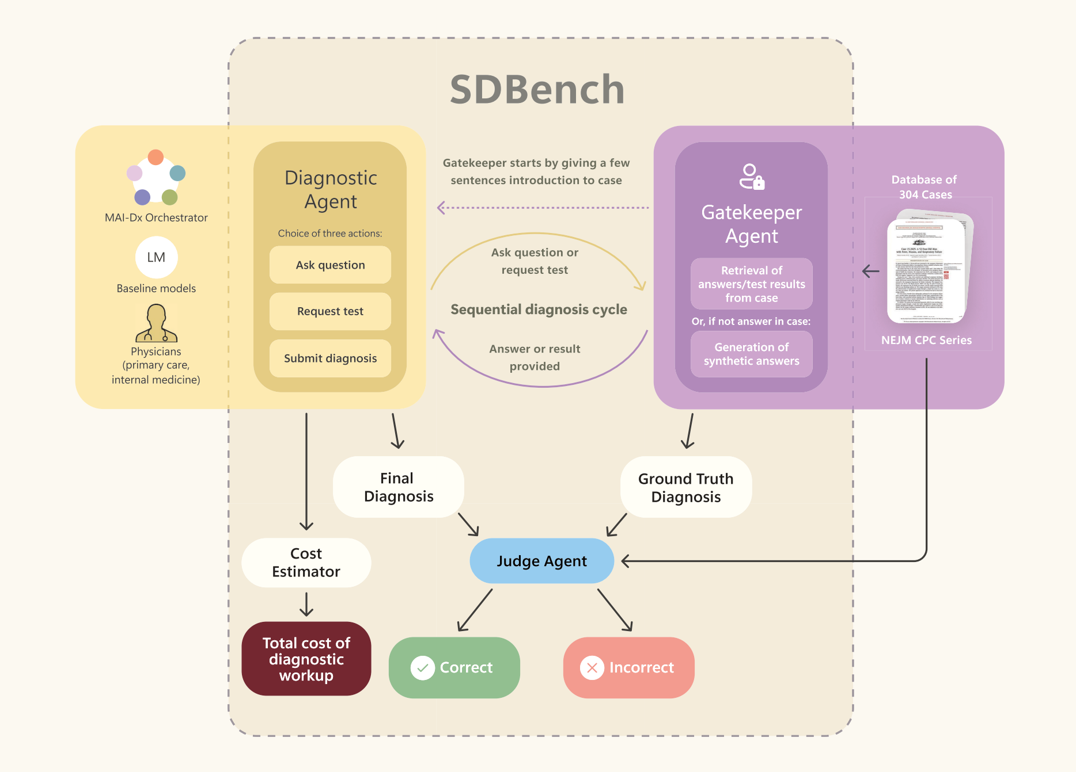

Slide 49
Theoretical Frameworks towards transparent reasoning behaviour
These frameworks are designed to meet two important criteria:
(a) low-level reasoning behaviour must be visible
(b) task-agnostic

Slide 50
Theoretical Frameworks towards transparent reasoning behaviour
Each framework would consist of three broad stages:
(a) data preprocessing
(b) model training
(c) interpretability via extraction of reasoning behaviour.

Slide 51

Initial input
Electronic Health and/or Medical Records
1
Preprocessing:
Data standardisation
Summarised, high-level, feature-lost information
Choice:
Deterministic models
Machine learning model
XAI:
Exposable reasoning
Resultingprediction
The patient has the common cold
Notes:
Theoretical frameworks figure (3 panel figure, one for each) - let this be part a for the simplistic framework

Slide 52
2
Patient Case
Patient Case
Diagnostic Algorithm
Diagnostic Algorithm
Symptom 1
Symptom 1
Present
Present
Not Present
Not Present
LLM
LLM
🧠
Extract
(Diagnostic Rules, CoT reasoning, LLM Attention Weights)
Extract
(Diagnostic Rules, CoT reasoning, LLM Attention Weights)
Symptom 2
Symptom 2
Not Present
Present
Not Present
Present
Diagnosis 1
Diagnosis 1
Diagnosis 2
Diagnosis 2
Diagnosis 3
Diagnosis 3
Symbolic Solver
Symbolic Solver
Symbolic AI
Symbolic AI
⚙️
⚙️
(Answer, Inference Chains)
(Answer, Inference Chains)
Notes:
Edinburgh diplopia diagnostic algorithm: https://www.nature.com/articles/eye201644

Slide 53
System 1
System 2
Conscious
Memory: Low-level information
Pattern-based
Instinct
System 1
System 2
Analytical
Thorough
Notes:
System 1 and System 2 thinking (single composite figure with annotated sectors, since both systems bleed into each other)
Evans and Stanovich, 2013]

Slide 54
2
Base LLM
(Question,Answer,Reasoning)
Fine-Tune
FT LLM
PRM
Alignment via PPO
RLHF LLM
Reasoning State
Correct Reasoning State
Reasoning Optimised Inference
Wrong Reasoning State
Prompt
Answer
Notes:
An illustration for a “reasoning first, post pretraining” medical LLM framework.

Slide 55

Open Challenges in (Medical) Large Reasoning Models

Slide 56
Open Challenges: Reasoning Data and Evaluation
Evaluation Metrics Beyond Accuracy
Traditional accuracy metrics miss the quality and structure of reasoning. [Mondorf and Plank, 2024]
Need metrics assessing logical soundness, coherence, and completeness of reasoning traces.
CLEVER [Liu et al., 2025] and R-IDEA [Cabral et al.,2024]rubrics (from human reasoning evaluation) can benchmark LLMs.
Judge LLMs enable scalable evaluation, but carry risks of bias from training data, requiring careful validation. [Li et al., 2025]

Slide 57
Open Challenges: Reasoning Data and Evaluation
Limited Availability of High-Quality Reasoning Traces
Rich, diverse Chain-of-Thought (CoT) datasets are scarce due to the high cost of clinician annotation.
Synthetic CoT generation using advanced LLMs is a promising workaround, leveraging their ability to produce multi-step rationales.

Slide 58
Open Challenges: Reasoning Data and Evaluation
Reasoning-Knowledge Entanglement
Current benchmarks often mix reasoning skills with factual recall.
This reflects a tension between:
System 1: Memory-based, fast pattern recognition [Evans and Stanovich, 2013]
System 2: Deliberate, logic-based reasoning [Evans and Stanovich, 2013]
True reasoning evaluation needs benchmarks that minimize prior knowledge dependency.
The ARC-AGI [Chollet 2019] benchmark is a strong example—it tests abstraction and reasoning from minimal information in non-medical domains.
No equivalent benchmark yet exists for the medical domain to isolate reasoning from memorization.

Slide 59
System 1
System 2
Conscious
Memory: Low-level information
Pattern-based
Instinct
System 1
System 2
Analytical
Thorough
Notes:
System 1 and System 2 thinking (single composite figure with annotated sectors, since both systems bleed into each other)
Evans and Stanovich, 2013]

Slide 60
Open Challenges: Training and Inference Optimisations
Scalability of RL-Based Approaches
RL methods like PPO[Schulman et al., 2017], DPO [Rafailov et al., 2023] and GRPO[Shao et al., 2024] improve reasoning, but are computationally expensive.
The challenge: develop lighter-weight RL techniques that still maintain reasoning quality for real-world use.

Slide 61
Open Challenges: Training and Inference Optimisations
Medical-Specific Reward Models
General-purpose reward models may not capture clinical nuance.
Utilise Process Supervision, which scores models on reasoning traces (not just final answers) [Lightman et al., 2023].
Process Reward Models (PRMs) automate this, trained on annotated CoTs to detect logical errors [Lightman et al., 2023].
Future direction: integrate PRMs directly into RLHF pipelines for scalable, domain-specific reasoning alignment.

Slide 62
Open Challenges: Training and Inference Optimisations
Scaling Laws for Inference-Time Reasoning
Increasing compute at inference time (not just training) improves reasoning depth [Xu et al., 2025;Sui et al., 2025].
Techniques:
Generate multiple reasoning paths (e.g., CoT [Wei et al., 2022], ToT [Yao et al., 2023])
Verify coherence with self-reflection [Shinn et al., 2023], Monte Carlo Tree Search [Duan and Wang, 2025], PRMs [Lightman et al., 2023]
Use fact-checking via web search for added trustworthiness
Takeaway: Smarter inference-time strategies can boost reasoning without retraining

Slide 63
Open Challenges: Alternative Reasoning Architectures
Limitations of Autoregressive LLMs
LLMs generate output one token at a time, conditioned on everything that came before.
They can’t revise or backtrack—one wrong token can cause a cascade of errors.
This limits their ability to plan or reflect during inference.
Promising Alternatives
JEPA [Asran et al., 2023]: planning-based, non-autoregressive models
Latent reasoning models [Zhu et al., 2025; Hao et al., 2024] perform internal computations in the hidden layers before generating any output:
Allow error correction and reflection before generation
Notes:
Joint Embedding Predictive Architecture (JEPA) is a self-supervised learning framework introduced by Yann LeCun to help AI systems learn in a more human-like way by predicting parts of the world from other observed parts without reconstructing every detail. Unlike traditional generative models, JEPA works in an abstract embedding space where it learns to predict meaningful, high-level representations rather than raw data.

Slide 64
Open Challenges: Multimodal Clinical Reasoning
Multimodal Clinical Reasoning Integration
Clinical data spans text, images, EHRs, sensor data, and physiological signals (e.g., ECG, EEG).
Future Large Reasoning Models (LRMs) must integrate these diverse modalities into a single reasoning framework.
This requires:
New data pipelines that go beyond current single-modality models
Rich, interconnected reasoning chains that mimic how clinicians make decisions using multiple data sources

Slide 65
A Few Last Thoughts on Reasoning…

Slide 66
A striking lack of evaluation methods for Reasoning Behaviour
Few evaluation frameworks truly capture the reasoning process in medical LLMs.
Conclusion-based metrics (e.g. accuracy) miss how the model arrived at its answer.
Rationale-based, interactive, and mechanistic evaluations better reflect true reasoning.
Example: SDBench simulates real diagnostic workflows, moving beyond static MCQs.

Slide 67
Memorisation vs Planning: The "Stochastic Parrot" Problem
We lack benchmarks to test whether answers are based on reasoning or memorization.
Ideal evaluation: test ability to reason from simple base facts (e.g. “The heart pumps blood”).
Closed-source models make this hard—calls for transparent, reasoning-focused test design.
Goal isn’t to discredit memorization (System 1), but to validate deeper System 2 reasoning.

Slide 68
Hallucination and Security Implications of Opaque Reasoning
Hallucinations (plausible but false outputs) stem from the autoregressive nature of LLMs.
Understanding reasoning chains helps detect and explain these hallucinations.
Security concern: Medical LLMs could be targeted or poisoned with misinformation.
Transparency into reasoning behaviour is critical for identifying tampering or logic corruption.

Slide 69
Reasoning Behaviour as a Form of Explainable AI
Reasoning behaviour ≈ a form of XAI for medical LLMs.
Viewing reasoning traces allows clinicians to better understand, validate, or contest model outputs.
Raises a key research question: Does better reasoning → better performance?

